Slide 1
Another PIG examle
http://hortonworks.com/hadoop-tutorial/how-to-use-basic-pig-commands/

Slide 2
Read in two data files that contain New York Stock Exchange dividend prices and stock prices. Then use these files to perform a number of Pig operations including:
Define a relation with and without schema
Define a new relation from an existing relation
Select specific columns from within a relation
Join two relations
Sort the data using ‘ORDER BY’
FILTER and Group the data using ‘GROUP BY’

Slide 3
You’ll need sample data for this tutorial. The data set you will be using is stock ticker data from the New York Stock Exchange from the years 2000-2001. Download this sample data from the following location:
https://s3.amazonaws.com/hw-sandbox/tutorial1/infochimps_dataset_4778_download_16677-csv.zip
The file is about 11 megabytes, and might take a few minutes to download.

Slide 4
Open the folder
infochimps_dataset_4778_download_16677 > NYSE
and locate the two data files that you will be using for this tutorial:
NYSE_daily_prices_A.csv
NYSE_dividends_A.csv

Slide 5
In this step, you will create a script to load the data and define a relation.
Line 1: define a relation with an input schema named STOCK_A that represents the NYSE stocks that start with the letter “A”
Line 2: use the DESCRIBE command to view the STOCK_A relation
The completed code will look like:
STOCK_A = LOAD 'NYSE_daily_prices_A.csv' using PigStorage(',') AS (exchange:chararray, symbol:chararray, date:chararray, open:float, high:float, low:float, close:float, volume:int, adj_close:float);
DESCRIBE STOCK_A;

Slide 6
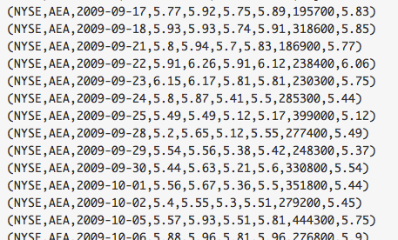
define a new relation based on an existing one.
Define the following B relation, which is a collection of 100 entries (arbitrarily selected) from the STOCK_A relation.
B = LIMIT STOCK_A 100;
DUMP B;

Slide 7
Select specific columns from a relation
One of the key uses of Pig is data transformation. You can define a new relation based on the fields of an existing relation using the FOREACH command.
Define a new relation C, which will contain only the symbol, date and close fields from relation B.
C = FOREACH B GENERATE symbol, date, close;
DUMP C;

Slide 8
Store relationship data into a HDFS File
STORE C INTO 'output/C';

Slide 9
Perform a join between 2 relations
Perform a join on two NYSE data sets:
the daily prices and the
dividend prices.
Dividends prices are shown for the quarter, while stock prices are represented on a daily basis.

Slide 10
The code
STOCK_A = LOAD 'NYSE_daily_prices_A.csv' using PigStorage(',') AS (exchange:chararray, symbol:chararray, date:chararray, open:float, high:float, low:float, close:float, volume:int, adj_close:float);
DIV_A = LOAD 'NYSE_dividends_A.csv' using PigStorage(',') AS (exchange:chararray, symbol:chararray, date:chararray, dividend:float);
C = JOIN STOCK_A BY (symbol, date), DIV_A BY (symbol, date);
DUMP C;
Notice C contains all the fields of both STOCK_A and DIV_A.

Slide 11
Sort the data using “ORDER BY”
Use the ORDER BY command to sort a relation by one or more of its fields.
DIV_A = LOAD 'NYSE_dividends_A.csv' using PigStorage(',') AS (exchange:chararray, symbol:chararray, date:chararray, dividend:float);
B = ORDER DIV_A BY symbol, date asc;
DUMP B;

Slide 12
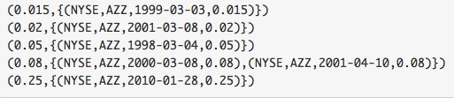
Filter and Group the data using “GROUP BY”
The GROUP command allows you to group a relation by one of its fields.
DIV_A = LOAD 'NYSE_dividends_A.csv' using PigStorage(',') AS (exchange:chararray, symbol:chararray, date:chararray, dividend:float);
B = FILTER DIV_A BY symbol=='AZZ';
C = GROUP B BY dividend;
DUMP C;
Congratulations! You have successfully completed the Using Basic Pig Commands tutorial.

